Slide 1
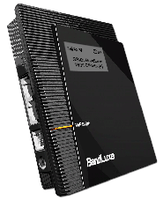
LTE Router
BandLuxe R50X
TROUBLESHOOTING guide

Slide 2
BASIC SET-UP

Slide 3
BASIC SET-UP

Slide 4
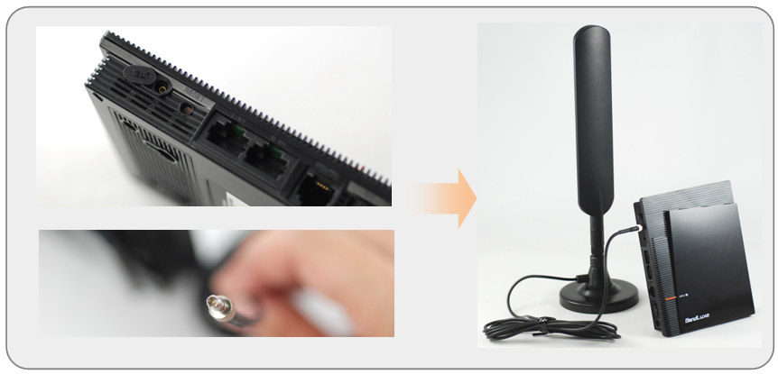
BASIC SET-UP
Connecting the External Antenna
Connector: SMK TS9

Slide 5

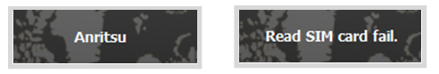
BASIC SET-UP
Have to be active
SIM Card
SIM card can be detected by BandLuxe LTE router.
(You can view this on the OLED Screen)
SIM Card is detected
SIM Card is not detected

Slide 6

BASIC SET-UP
Check signal strength:
(You can view this at the upper-left part
Of OLED screen)
SIM Card
No Signal
Good Signal

Slide 7




BASIC SET-UP
Check device radio access network
(You can view this on the left of the device)
Device
LTE
EDGE
HSPA/HSPA+
GSM/GPRS
WCDMA

Slide 8
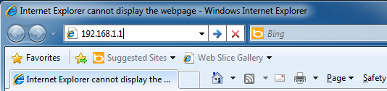
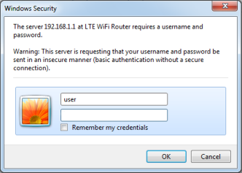
BASIC SET-UP
Default IP address (http://192.168.1.1)
URL (http://R500.ROUTER)
Device
-Log In
Default User Name and Password
are user | (leave the password as blank)

Slide 9
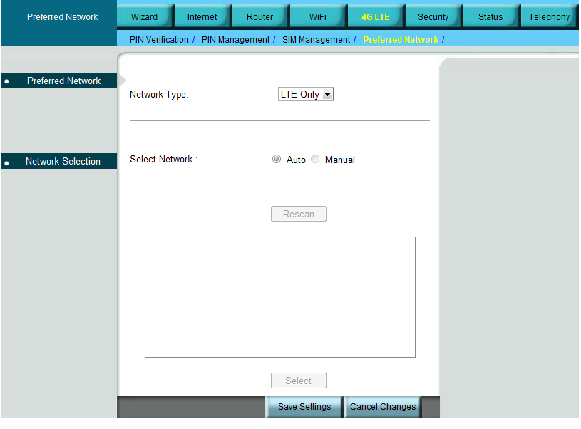
BASIC SET-UP
Check Network Set-Up:
Device

Slide 10
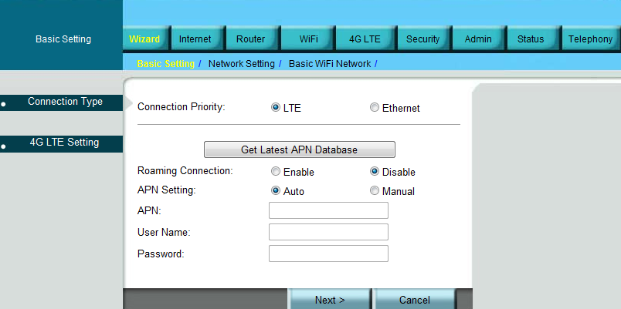
BASIC SET-UP
Check Access Point Name (APN):
Device

Slide 11
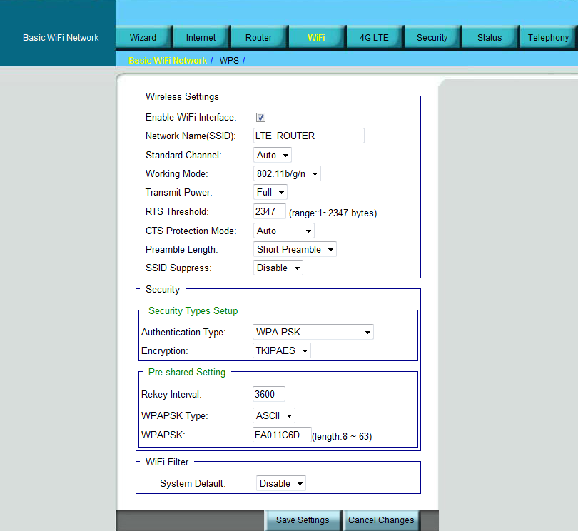
BASIC SET-UP
Default Network Name(SSID) is LTE_ROUTER,
network security key is last 8 digits of WLAN MAC
Device
-WiFi
If failed, log into the R500 to change WiFi setting
or restore to factory default setting.

Slide 12

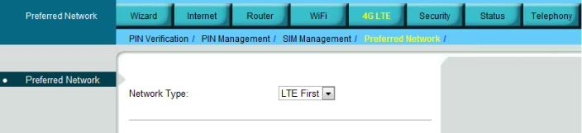
NO INTERNET CONNECTION
Remove then re-insert SIM Card in the router.
If No Signal, Change Radio Settings based on your internet activity:
SIM Card can’t be detected /No Signal
If Poor Signal, change location of router to another area

Slide 13
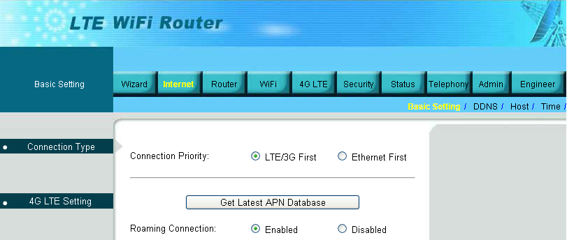
NO INTERNET CONNECTION
Ensure that correct Access Point Name (APN) supplied by the SIM card carrier.
Can not
connect to internet.
If it’s roaming, set “Roaming connection” as Enabled
Make sure that your signal is stable

Slide 14
Temporarily turn off anti-virus and firewall.
The anti-virus and firewall might be the possible cause.
Slow internet connection
Check signal
Check there’s only one user using the router
(ex: Set Maximum number of users to “1”…)

Slide 15
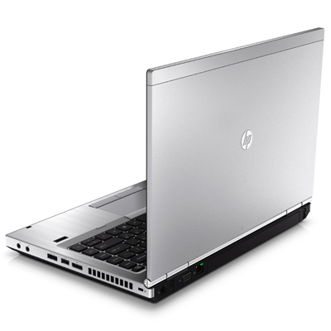
Check computer specifications:
Recommended specifications:
Pentium IV or higher
512 MB of RAM or higher
USB 2.0 port
50 MB free disk space
Slow internet connection

Slide 16
VPN
The default IP Address of BandLuxe R500 is 192.168.1.1
If the VPN fails, make sure that the segment of R500's IP is not overlap with the company’s.
i.e. If the IP address of the company Server is 192.168.1.1
then, configured the IP address of BandLuxe R500 to 192.168.x.x

Slide 17
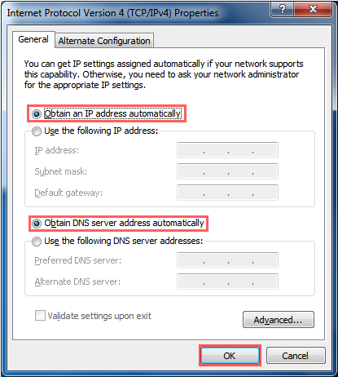
Install and Configure problem
- Why can't I link on the R500 GUI
Hardware connection:
1. Check if the Ethernet cable connecting between the PC-Ethernet and R500-LAN port
2. Check if the Ethernet cable is working
PC’s setting:
1. Go to Start > Control Panel > Network and Internet >
Network and Sharing Center > Change adapter settings
2. Right click on the Local Area Connection and select Properties
3. Select Internet Protocol Version 4 (TCP/IPv4) from the list of
items and click Properties.
4. Ensure the radio buttons beside Obtain an IP address
automatically is selected. Click OK.

Slide 18
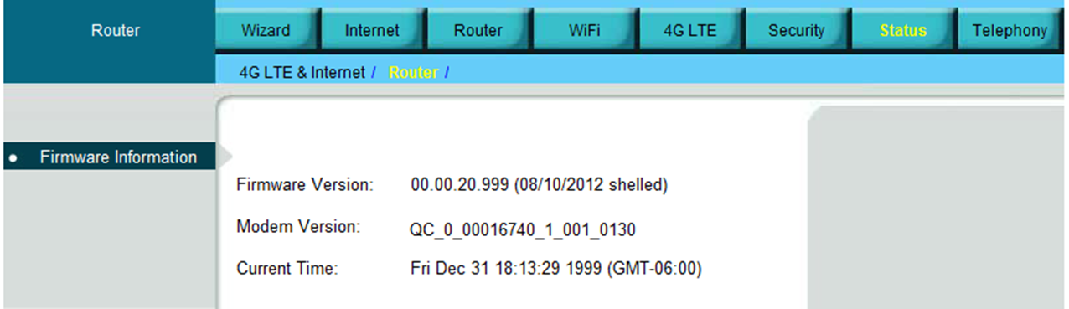
Knowing the R500 version
1. Go to Status > Router
2. In Firmware Information, the Firmware version and Modem Version displayed here.

Slide 19

End
BandRich Inc.

